Slide 1
Lecture No. 5 Storage Devices - Batteries
At the end of this lecture, students will be able to:
Explain the components of a battery
Discuss primary and secondary batteries
Describe characteristics of a good battery
Explain the construction and working of a super capacitor

Slide 2

Storage Devices - Batteries
Indian battery market is a $ 1 billion market including the two market sub-segments "lead acid batteries" and “Li-ion batteries”
Manufacturing of lead acid batteries in India
Importing of Li-ion batteries
Automobile industry is the biggest demand driver of lead acid batteries
Major Traction Battery
Suppliers
Ref: www.researchandmarkets.com

Slide 3
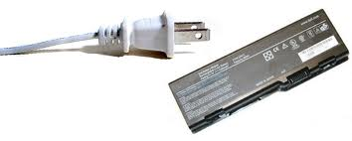
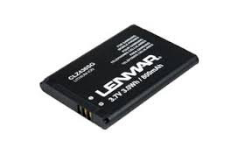
Storage Devices - Batteries
Mobile phone and computer industries are the most important growth driver for Li-ion battery demand
Complete demand is covered by imports (e.g. from Korea and China)
Global battery market is about US $86 billion, of which roughly US $50 billion is allocated to rechargeable (secondary) batteries
Growth is estimated at 6% annually through 2014
Forecast of the Battery market in India to grow at
a compound annual growth rate (CAGR) of 16.5
percent over the period 2014-2019
Ref: www.researchandmarkets.com

Slide 4
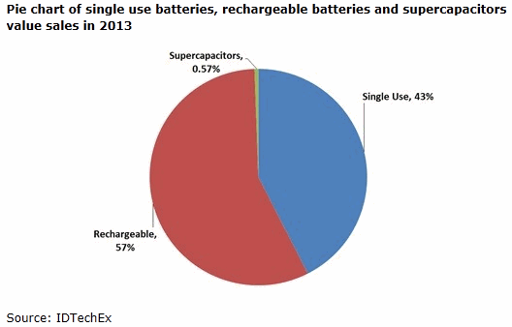
Storage Devices - Batteries
China, India, Brazil, the Czech Republic and South Korea will record some of the strongest market gains
Global market for (Electric)Car Traction batteries will be $37 billion by 2020
Current trends in utilization of electronic gadgets demand miniaturization of these batteries
Demand is ever increasing with the increase in population and its quest for comforts
Ref: www.researchandmarkets.com

Slide 5
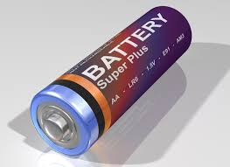
Storage Devices - Batteries
^{What is a battery?}
Battery is a device consisting of one or more electrochemical cells that convert stored chemical energy into electrical energy
Working principle of a battery is that the transformation of free energy change of redox reactions of the electrode active materials into electrical energy

Slide 6
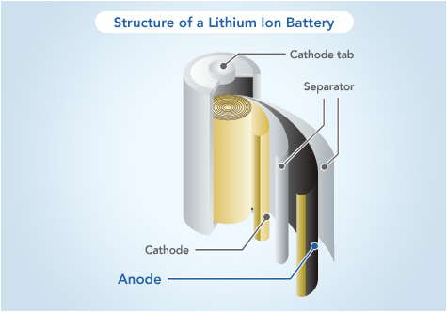
Conversion and Storage - Batteries
Components of Battery
Anode (-ve electrode): Oxidation reaction – liberation of electrons , material should be easily oxidizable, high coulombic output, good conductivity, stable with electrolyte, ease of fabrication and low cost
Cathode (+ve electrode): Reduction reaction - accepts electron, material should be easily reducible, stable with electrolyte, have useful working voltage
Electrolyte: Provides medium of ionic transfer inside the cell between anode and cathode, should have good ionic conductivity

Slide 7
Classification of Battery
Batteries are classified into three types as follows.
Primary
Secondary
Reserved
Primary Batteries:
Batteries which serve as a source of energy, as long as the active chemical species are present in the battery or in the cell
Cell reactions are irreversible
Designed for only single discharge and cannot be charged again
Ex: Dry Cell, Zn – Hgo cell, Zn-Ag2o cell etc.,

Slide 8
Classification of Battery
Secondary Batteries:
Batteries are chargeable and can be used again and again.
Cell reactions are reversible and are often called reversible batteries
During discharging the cell acts like voltaic cell or Galvanic cell converting chemical energy into electrical energy
During charging the cell acts like electrolytic cell by converting electric energy into chemical energy, hence these batteries are called as storage battery
Ex: Lead acid Battery, Ni-cd battery etc

Slide 9
Classification of Battery
Reserved Batteries:
Batteries which can be stored in an active state and made ready for use by activating them prior to the applications (usage) are called as reserved batteries.
Key components of the batteries such as electrolyte etc., is separated from the battery
Ex: Mg – water activated batteries (Mg- Agcl & Mg cucl), Zn-Ag2O Batteries etc

Slide 10
Battery Characteristics
A good battery must have the following characteristics.
Voltage:
Voltage of a battery depends on the energy change in the overall cell reaction and the nature of cell reaction
To obtain maximum voltage from a cell
Potential difference between the electrodes must be high
Resistance of the cell must be low
Electrode reactions must be fast to reduce the over potential
E_{cell} = (E_{C} – E_{A}) - [ η_{A} - η_{C} ] - iR_{cell}

Slide 11
Battery Characteristics
Voltage:
Electrode reactions should be so chosen as to ensure that the active mass at the positive electrode reduces readily and that at the negative electrode oxidizes easily leading to an overall reaction with a high negative free energy change
Cell should be designed to minimize voltage drop
Can be achieved by keeping the electrodes close to each other and also by using an electrolyte of high conductivity

Slide 12

Battery Characteristics
Capacity (C):
Capacity of a battery is the charge or the amount of electric current that can be obtained from a battery
It is charge in ampere hours (Ah).
Capacity of a battery depends on
Size of a battery
Discharge conditions
Capacity of a battery is to be determined by
Where,
C = Capacity of battery (in Ah), W =Weight of the active material
n =number of electrons, F = Faradays constant, M Molar mass

Slide 13
Battery Characteristics
Capacity
Plot of V against T at a fixed current discharge is shown in Fig
Variation of the battery voltage during discharge is shown by the flatness of the curve
Length of the flat portion of the curve is a measure of the capacity of the battery; longer the flat portion of the curve better is the capacity
Voltage
E^{min}_{cell}
TIME

Slide 14


Battery Characteristics
Energy density:
Energy density is the ratio of energy available from a battery to its weight or volume
Power density:
Measure of how much power can be extracted from a battery per unit battery weight
It is the ratio of power available from a battery to its weight or volume during discharge power density decreases

Slide 15
Battery Characteristics
Energy efficiency:
Battery should have high-energy efficiency
Percent energy efficiency can be calculated using
Cycle Life:
Primary batteries are designed for single discharge
Secondary batteries can be chargeable again and again
Number of charge and discharge cycles that are possible in secondary batteries, before failure occurs is called cycle life
Cycle life of batteries must be high
Li-ion battery retains more than 65% capacity after 2000 cycles

Slide 16
Battery Characteristics
Shelf life:
Duration of storage under specified conditions at the end of which a cell or a battery retains its ability to work or to produce energy is called shelf life. A good battery should have more shelf life
It depends on self-discharge reactions and corrosion at contact points

Slide 17
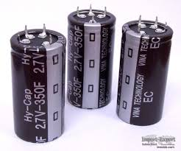
Storage Devices - Supercapacitors
Supercapacitors:
Supercapacitor (also known as an ultra capacitor) is an electrochemical capacitor that has a very high energy density compared to common capacitors
Supercapacitors are passive electrical devices that store charge
Looks very much like a battery, but stores energy in an electrostatic field, rather than as a chemical state
Application of voltage to the supercapacitor creates an electric field between the charged electrodes

Slide 18
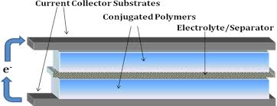
Supercapacitors
This electric field causes the electrically charged ions in the electrolyte to migrate towards the electrodes of opposite polarity during charging
Two separate charged layers are produced
Since no chemical action is involved, the effect is easily reversible and the typical cycle life is hundreds of thousands of cycles

Slide 19
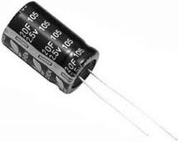
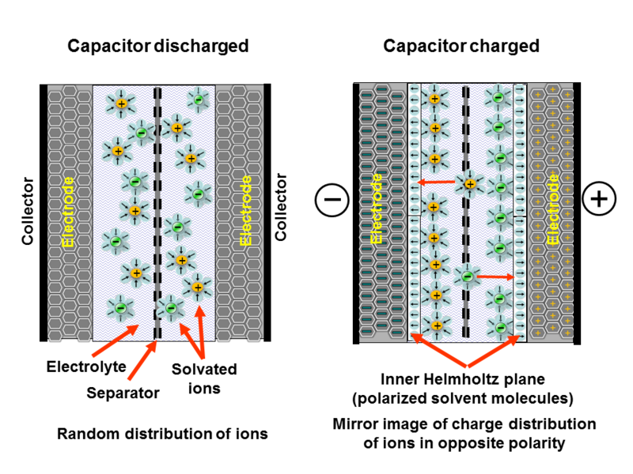
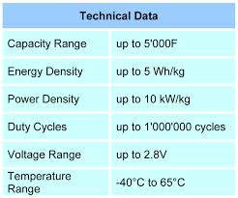
Supercapacitors
How Supercapacitor Works?

Slide 20
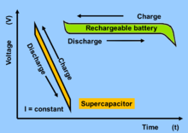
Supercapacitors
As an energy storage device super capacitors have both high power and high density (as opposed to a battery, which has very high energy, but low power)
It is able to store a large amount of charge (energy) that can be released very quickly
Well suited for short-term, high-energy applications
Super capacitors are generally employed in conjunction with a battery string to provide for an uninterrupted power supply
Properties of supercapacitors vary depending on electrode materials (activated carbon, carbide derived carbon, graphene, metal oxides, etc.)

Slide 21
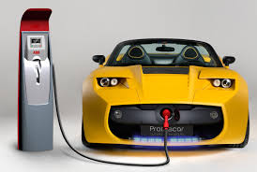
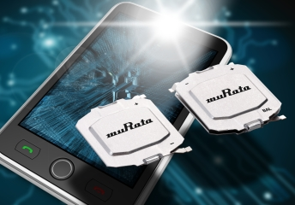
Supercapacitors
By combining a super capacitor with a battery-based uninterruptible power supply system, the life of the batteries can be extended
Batteries provide power only during the longer interruptions, reducing the cycling duty on the battery
Applications:
In future they can be used in consumer electronics, cell Transportation, Military, Energy – Utility power such as smart grids
phones, tablets, electric cars (still large scale supercapacitors are being in the development stage)

Slide 22
Summary
Batteries – Market scenario – US$ 1 Billion market
Characteristics of a good battery
Voltage, Capacity, Energy efficiency, power density, energy
density, cycle life, shelf life
Construction and working principle of a supercapacitor: electrochemical capacitor that has a very high energy density compared to common capacitors
Applications: Transportation, Military, Energy – Utility power such as smart grids

Slide 23
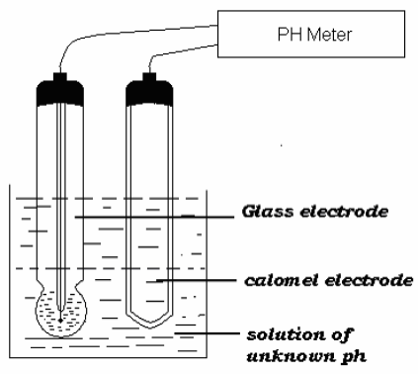
PH using glass electrode
Explain the determination of PH using glass electrode
Combined electrodes can be represented as
Hg(l) / Hg2 Cl2 (S) / Saturated KCl //solution of unknown pH /glass /0.1M HCl/Ag/AgCl(s)

Slide 24
PH using glass electrode
PH using glass electrode
Emf of the above cell is given by
E cell = E cathode – E anode
E cell = E calomel – E glass
E glass = E calomel – E cell
The potential of E glass is given by
E glass = - RT/nf ln [a2/a1]
= RT/nf ln [a1/ a2]
Where a1 = Concentration of [H+] ions in glass bulb
a2 = Concentration of [H+] ions in unknown solution

Slide 25
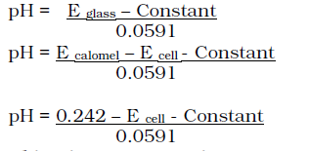
PH using glass electrode
E glass = RT/nf ln [a1] – RT/nf ln [a2]
E glass = Constant – RT/nf ln [a2 ] (Because an [H+] ion in glass bulb is constant)
E glass = Constant – 0.0591 log [H+]
E glass = Constant + 0.0591pH

